Slide 1

INTRODUCTION
We have made an e-shopping site—TAKE IT N GO...
CREATED by
FALAK
RAKESH
ASHISH
ATUL
ROMA

Slide 2
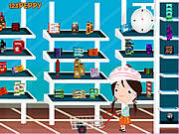
EXISTING SYSTEM...
The existing system work manually. All above the data need to be maintained on ledgers and maintaining this is a tedious and risky process.
Some of the negative aspects of the existing system are as follows:
Course of action is time consuming.
Wherever a need for search arises,
the process evolves search through
paper records.
Readability of records is constrained. All the records may not be handled or written by the same person. So the format and style of records differ and hence it is difficult to understand.
Paper records are easily damaged in course of time. The life time of paper record is unreliable less that it easily gets spoiled

Slide 3

PROPOSED SYSTEM...
The proposed system is a computerized one. This has greater accuracy and efficiency. This takes only limit. Through a Web browser, a customer can browse the catalog, place items to purchase into a virtual shopping cart, create and sign in to a user account, and purchase the shopping cart contents by placing an order with a credit card.
By integrating information and improving processes, emart will help improve enterprise-wide decision support and operational efficiency. Improved efficiency translates into:
More resources to support the enterprise .
Improved customer service
Web-based and more user friendly interfaces to buyers .
An extremely powerful marketing tool, emart’s ability
to suggestively sell alternate and complementary products;
e.g. if a customer selects the "standard" version of a product,
you can recommend that they also consider the "pro" version
or if your customer chooses a pair of pants, you can suggest that
they also consider a belt ed time for calculation

Slide 4

HARDWARE REQUIREMENTS
Main Processor Pentium IV
Hard-disk Capaity 8 G.B
RAM 256 MB
Monitor V.G.A
4.2 Software specification

Slide 5

SOFTWARE
REQUIREMENTS
Operating System: Windows XP
The system will be built on windows compatible
environment. The application will be web based developed using Java technology.
Client Side Application Software: Java Script, HTML
Data Base: Oracle 8i
The system requires Oracle as a database; however the system will be ODBC complaint to work on any standard database.
Client Browsers:
Internet Explorer 5.0 or Netscape Navigator 4.7
The system requires Internet Explorer or Netscape Navigator browser for client side.
Dream Weaver 8.0
The system will be developed with Java Technologies using J2SE (JDK and JRE). Dream Weaver 8.0/ Front Page 2003 as HTML editor.

Slide 6
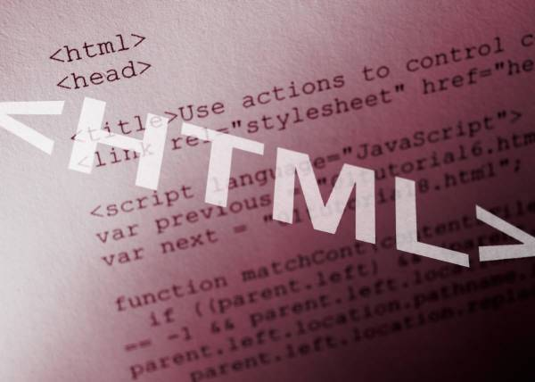
HTML
HTML(Hyper Text Markup Language): A markup
language used to structure text and multimedia
documents and to set up hypertext links between
documents, used extensively on the World Wide Web.
HTML is a programming language. HTML is a markup language(the ML in HTML) that uses a fixed set of markup tags.
HTML itself is the set of customizable “markup” tags that are inserted into HTML document govern its format, multimedia content, and hyperlinks. Any HTML viewer can display such documents but they are normally viewed using a Web browser.
HTML is a programming language in that an HTML document is a program that, when “run” by a browser, displays its text as hypermedia (multimedia with hyperlinks).
The “language” HTML is really only a collection of predefined tags which , when inserted into regular text.

Slide 7
JAVASCRIPT...
Javascript is a compact , object-based scripting language. It can provide interactive web pages, validate from data, and make your web page clearer. Javascript is a lightweight interpreted scripting language.The language is most well known for its use in websites.It was originally developed by Brendan Eich of Netscape Communications. It adds interactive functions to HTML pages, which are otherwise static. Javascript is easier to use than Java, but not as powerful and deals mainly with the elements on the Web page. On the client, JavaScript is maintained as source code embedded into an HTML page. On the Server, it is compiled into byte code(intermediate language), similar o Java pogramms.
Features Of JavaScript:-
JavaScript was designed to add interactively to HTML pages.
JavaScript is a scripting language-a scripting language is a lightweight programming language.
A JavaScript is usually embedded directly in HTML pages.
A JavaScript is an interpreted language(means that script execute without preliminary compilation).
All major browsers, like Netscape and Internet Explorer, support JavaScript.

Slide 8
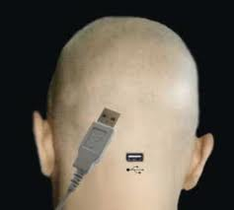
FUTURE SCOPE...
Since this system has been generated by using Object Oriented programming, there are many chances of reusability of the codes in
other environment even in different
platforms. Also its
present features can be
enhanced by some simple modification in the codes so
as to reuse it in the
changing scenario

Slide 9
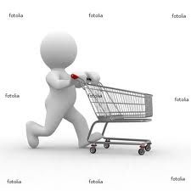
CONCLUSION....
As evidence of the success of this mission,
there are millions of items listed each day in
thousands of different categories. There are
items for almost any interest that one could imagine, from sheet music to automobiles to hand tools to real estate. And the variety doesn’t stop there. Need a computer? One may find it listed in the proper category, in any configuration from very old and obsolete to the latest greatest machine available. What about antiques? One can find an antique quilt that is up for highest bid, or maybe an old violin, whose beautiful tones have enchanted many though its years. Tickets. Maybe a ticket to the next concert of ones favorite artist or play production. One can even find that special bottle of wine, some aged, exotic cheese, and the perfect ‘mood’ music for that special occasion

